Slide 1
Sales Dashboard Summary Task-4
By: Prerna Lugade

Slide 2
The objective of this dashboard is to provide a clear and interactive overview of sales performance across different categories, regions, and time periods. It enables stakeholders to monitor key performance indicators (KPIs) like total sales, profit, and order volume, supporting data-driven decision making.
Objective

Slide 3
Key KPIs
KPI | VALUE
Total Sales | 1.6M
Total Profit | 175K
Total Orders | 22K
Shipping Day | 4 Days

Slide 4
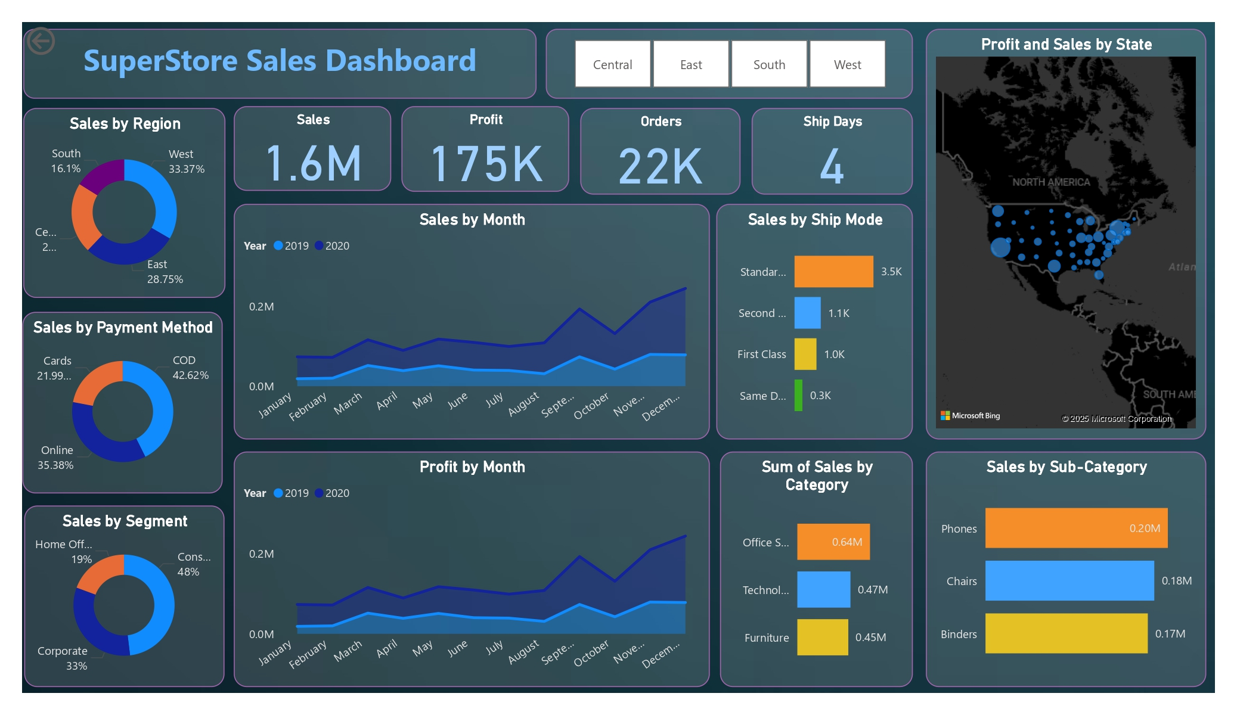
Power BI Dashboard Overview

Slide 5
Key Insights
The West region generated the highest total sales.
Technology category had the greatest profit margin.
December recorded the highest sales volume.
Office Supplies performed best in the Central region.

Slide 6
Filters & Features
Slicers included for Region, Category, and Segment.
Time-series analysis using monthly sales and profit trends.
KPI Cards for quick performance overview.
Interactive features allow easy data exploration and drill-down.

Slide 7
Recommendations
Focus marketing efforts on the West region.
Invest more in the Technology category.
Optimize logistics ahead of Q4 peaks (e.g., December).
Improve strategies in low-performing regions like the South

Slide 8
Thank You !!

